Slide 1
StegAnalysis
Instructor:
Behnoud shafizadeh

Slide 2
Related works in deep learning
In recent years, the development of deep convolutional neural networks has pushed the boundaries of steganalysis research.
In 2015, Qian et al. published a simple deep learning model that showcased the potential for CNN-based steganalysis .
in 2016, Xu et al. was able to achieve state-of the art results using a more complicated network structure.
In 2018, researchers released several new architectures, including Ye-Net ,which used truncated linear activation functions .
Yedroudj-Net ,which used a small network that could learn with small datasets to reduce computational costs .
SRNet ,which could be adapted to spatial or frequency steganalysis.

Slide 3
Related works in deep learning
most research in the steganalysis domain has focused on :
Developing architectures that boost steganographic signal, since steganalysis operates in a low signal to noise ratio environment.
developing architectures with better convergence guarantees and reduced computational costs .
Recently, researchers have found that many steganalyzers previously considered to be state-of-the-art are particularly non-robust and have a number of failure modes . Specifically, these steganalyzers fail at the source mismatch problem, low embedding ratio problem, and steganographic embedder mismatch problem. They are also prone to adversarial attacks.
Next, researchers have also worked on understanding how to robustly evaluate steganalyzers. Recent work has taken two approaches to tackling the evaluation issue:
formulating standardized methodologies that lead to robust evaluation :
Zeng et al. finds that current steganalyzers are particularly bad at the source mismatch problem and argues that steganalyzers should be evaluated on increasingly diverse source distributions .
Prokhozhev et al. proposes several tactics to improve evaluation methods involving steganographic embedder mismatch problem and the use of large test datasets .
Chaumont et al. finds that researchers should test steganalyzers on more diverse datasets (i.e. image source, image resolution, image format) to evaluate how practical a steganalyzer is.

Slide 4
Related works in deep learning
design and generation of steganographic datasets that allow for evaluation:
When designing these datasets, researchers focus on
(1) cover image sources and (2) steganographic embedder diversity.
The most commonly used evaluation dataset is the BOSS dataset ,which contains gray-scale 512x512 images. More recent work has criticized widespread use of BOSS since it contains limited image diversity .
Another dataset in this issue is:
SIG
StegoAppDB
iStego100k
Notice:these datasets are unchanged and static, their usability diminishes over time and they are rarely adopted by the steganalysis research community.

Slide 5
Universal and Practical Steganalysis(Towards Universal Steganalysis)
Universal steganalysis is defined as a class of steganalyzers that can detect any known or unknown steganographic embedder. We identify the following problems that a universal steganalysis solution must solve:
Source Mismatch Problem - Universal steganalyzers must be able to detect steganographic images regardless of the image source.
Steganographic Embedder Mismatch Problem - Universal steganalyzers must be able to detect steganographic images from any steganographic embedder , including those that they have not been seen before.
Low Embedding Ratio Problem - Universal steganalyzers must be able to detect steganographic images that are embedded with low embedding ratios.
By solving these problems, a steganalyzer would be able to function as a universal steganalyzer in any context.

Slide 6
Towards Practical Steganalysis
Practical steganalyzers must be effective in real-world situations. From a deep learning perspective, this means that models must be efficient and applicable in a diverse set of contexts. Towards this goal, we identify the following problems that a practical steganalysis solution must solve:
Image Size Mismatch Problem - Practical steganalyzers must be able to operate on arbitrary image sizes (i.e. 256x256, 512x512, etc.) so that they can be usefully deployed in an application.
Training and Execution Efficiency Problem - Practical steganalyzers must be able to be trained and updated efficiently so that new training examples can be quickly incorporated into the model. They must also be able to execute efficiently so that they can process a large of number of images quickly.

Slide 7
Dataset Augmentation
data augmentation procedures that generate datasets that can be used to train universal deep learning steganalyzers. Data augmentation is a technique used to artificially expand the training dataset by introducing image modifications that increase the diversity of the dataset. Research in the last few years has shown that data augmentation effectively improves the robustness of deep learning models by providing useful training features.
the following data augmentation procedures that researchers should consider using to augment their steganographic training datasets:
Source diversity
steganographic embedder diversity
embedding ratio diversity

Slide 8
Source Diversity
To solve for the source mismatch problem, we suggest augmenting training datasets with a large sampling of source distributions. We suggest the following data augmentations:
A large variety of camera configurations should be present in the dataset to ensure that that the training dataset contains many source distributions.
A large variety of image sizes and image formats should be present in the dataset to ensure that the training dataset contains a diverse set of source image types.
Standard data augmentation techniques such as random crops, rotations, and translations should be employed to artificially increase source diversity.
By using a diverse set of training images, source distribution signals that confound steganographic signals will be less useful for prediction.

Slide 9
steganographic Embedder Diversity
To solve for the steganographic embedder mismatch problem, we suggest augmenting training datasets with a diverse set of steganographic embedders. We suggest the following data augmentations:
Datasets should skew towards using hard-to-detect steganographic embedders (i.e. SteganoGAN), since they create a more challenging steganalysis problem and provide more useful steganographic signal.
To test universal steganalyzers, the test dataset should be augmented with steganographic embedders that have not been trained on and, preferably, are characteristically different from the training dataset steganographic embedders.

Slide 10
Embedding Ratio Diversity
To solve for the low embedding ratio problem, we suggest augmenting training datasets with a diverse set of embedding ratios. We suggest the following data augmentation:
A large range of embedding ratios should be used for training so that models do not over-fit to a specific embedding ratio. We suggest a range from 0.05 bpp to 1.0 bpp. For deep learning steganographic embedders, researchers should consider increasing the range of embedding ratios present in the training dataset.
Using a wide range of embedding ratios will force models to better learn to detect steganographic signal and prevent overfitting for a specific embedding ratio.

Slide 11
Proposed CNN architectures for steganalysis
we describe two deep learning architectures that provide potential solutions to the challenges facing practical steganalysis.
In pervious sections, we identified that a practical deep learning steganalyzer must be able to solve the following problems: the image size mismatch problem and the training and execution efficiency problem.
To help realize these goals, we use modern CNN methods to design:
ArbNet :
which is compatible with arbitrary input image sizes using a modified DenseNet architecture
FastNet :
which uses a modified EfficientNet architecture to improve computational efficiency.

Slide 12
ArbNet
To solve for the image size mismatch problem, we introduce ArbNet (Arbitrary Image Network), which uses several modifications to the architecture presented in Singh et al. Singh et al. presents a DenseNet structure adapted to fit the steganalysis problem. We use this architecture and modify it in the following ways:
TLU Activation Units. TLU activation units are used instead of ReLU to extract weak steganographic signal.
Modified ConvBlocks. The number of convolutional blocks and specific convolutional layer parameters are modified .
Spatial Pyramid Pooling. Spatial pyramid pooling (SPP), is used instead of global average pooling to boost steganographic signal and enable arbitrary image size detection. SPP produces fixed-length representations at various scales that are invariant to input size.

Slide 13
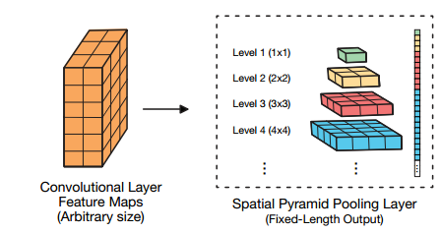
Components of ArbNet
A spatial pyramid pooling (SPP) layer is invariant to input size since it fixes the output size of the pooling layer. Each SPP layer fixes how many sections the input will be divided into for pooling. In this figure, the third layer divides the convolution input into nine pooling sections .

Slide 14
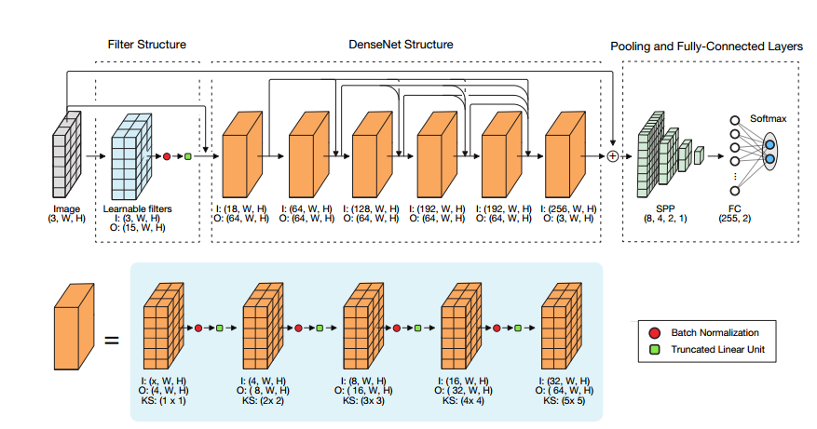
Architecture of ArbNet
ArbNet is a steganalysis CNN model that can be applied to arbitrary image sizes. First, the input image is fed through 15 filters that are initially initialized with 15 SRM HPF’s. Next, the input image and filtered output are fed into a DenseNet structure. Finally, the residual output from the DenseNet is combined with the original image and fed into a spatial pyramid pooling layer, a fully-connected layer, and a softmax function to output the steganographic and cover probabilities.

Slide 15
Conclusion of ArbNet
Each step helps boost weak steganographic signal and makes the model effective in a low signal-to-noise ratio environment. We believe that ArbNet holds a key solution to the image scaling problem as it effectively avoids downsampling input signal while enabling arbitrary image size detection.

Slide 16
FastNet
To solve for the training and execution efficiency problem, we introduce FastNet (Fast Network), which adapts EfficientNets to the steganalysis problem.
EfficientNets are a family of image classification models which achieve state-of-the-art accuracy but are an order of magnitude smaller and faster than previous models , EfficientNets are trained by successively improving older models through a model-scaling process that modifies network depth, width, and resolution.
EfficientNets use MBConv blocks, which can be used for neural architectural search, enabling EfficientNet to use the most effective neural architecture

Slide 17
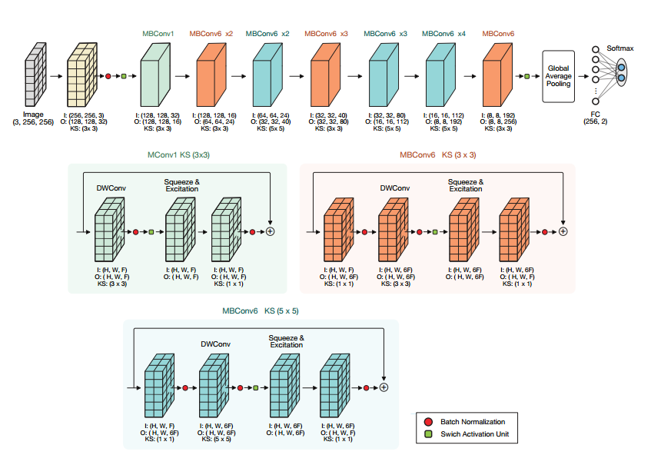
Architecture of FastNet
FastNet uses the EfficientNet-B0 structure and modifies the final few layers to adapt the network to the steganalysis problem. FastNet is composed of MBConv blocks which enable neural architecture search and computationalefficiency.

Slide 18
Evaluation of system
Steganalysis evaluation datasets are defined by three key parameters:
Source dataset
steganographic embedder
embedding ratio
Source Diversity: The system must be able to access a large, diverse set of source distributions. In addition, the system must provide a large selection of dataset and image processing tools for data augmentation.
Steganographic Embedder Diversity: The system must integrate with a large and diverse set of steganographic embedders. Embedding Ratio Diversity: The system must be able to apply steganographic embedders with a wide selection of embedding ratios.

Slide 19
Standard Steganalysis Evaluation
For a steganalysis evaluation system to be useful, it must adhere to standard evaluation methodologies for binary classification tasks and produce reproducible metrics that can be fairly compared to other steganalysis research.
Comparable Metrics: The system must produce standard binary classification metrics that are accurate and comparable to other steganalysis research to enable meaningful and fair comparisons.
Reproducible Metrics:The system must produce reproducible metrics so that steganalysis performance can be fairly reviewed.
Steganalyzer Diversity: The system must integrate with a large and diverse set of steganalyzers to enable comprehensive and robust comparisons.

Slide 20
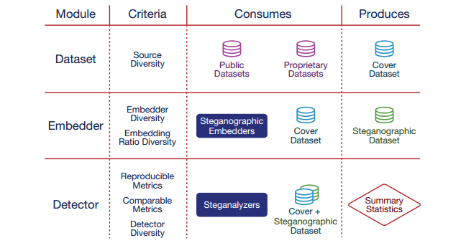
Overall process

Slide 21
List of public datasets
ALASKA
BOSS
BOWS2
MSCOCO
DIV2K

Slide 22
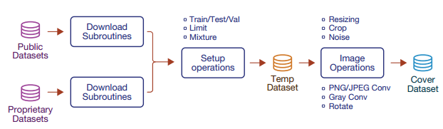
Process of generation cover dataset
The dataset module generates cover datasets. The module provides subroutines to either download or load public/proprietary datasets. The module then applies any user-specified setup or image operations to produce diverse cover datasets. The dataset module provides a large set of modification operations and out-of-box access to several large datasets to generate robust cover datasets.
Load Image Datasets
Apply Dataset Setup Operations
Apply Image Operations
Assign UUID and Extract Metadata

Slide 23
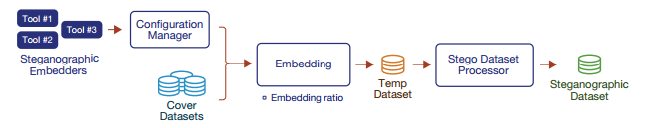
Embedder Module
The embedder module generates steganographic datasets. Using the StegBench API, users can load steganographic embedders that are defined in configuration files via the configuration manager as well as specify any cover dataset(s). Next, using user-supplied embedding configurations, the module applies steganographic embedders to generate temporary steganographic images, which are then processed and combined into a steganographic dataset.

Slide 24
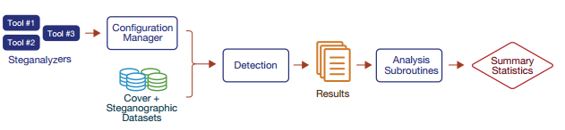
Detector Module
The detector module evaluates steganalyzers across cover and steganographic datasets. Using the StegBench API, users can load steganalyzers that are defined in configuration files via the configuration manager as well as specify any cover or steganographic dataset(s). Next, the module evaluates each steganalyzer on the dataset images, collects these results, and uses analysis subroutines to properly generate summary statistics.

Slide 25
Problems in MIT version
Java version
Many complexity :
Embedding procedure
Cover dataset
Detect procedure
You must make each level separately while in another papers you have seprate folders as cover and stego so you must not make datasets and you don’t need embedding procedure.

Slide 26
Thanks for your consideration.

